Slide 1
Caudal Anesthesia
By
Dr M Sabra

Slide 2
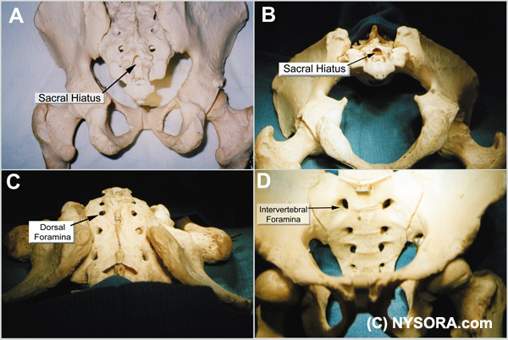
Caudal anesthesia was first described at the turn of last century by two French physicians, Fernand Cathelin and Jean-Anthanase Sicard. The technique predated the lumbar approach to epidural block by several years.

Slide 3
Anatomic Considerations
The sacrum is a large triangularly shaped bone formed by the fusion of the five sacral vertebrae. It has a blunted, caudal apex that articulates with the coccyx. Its superior, wide base articulates with the fifth lumbar vertebra at the lumbosacral angle . Its dorsal surface is convex and has a raised interrupted median crest with four (sometimes three) spinous tubercles representing fused sacral spines.
The caudal opening of the canal is the sacral hiatus , roofed by the firm elastic membrane, the sacrococcygeal ligament, which is an extension of the ligamentum flavum. The fifth inferior articular processes project caudally and flank the sacral hiatus as sacral cornuae, connected to the coccygeal cornua by intercornual ligaments.
The sacral canal is formed by the sacral vertebral foramina and is triangular in shape. It is a continuation of the lumbar spinal canal. Each lateral wall presents four intervertebral foramina, through which the canal is contiguous with the pelvic and dorsal sacral foramina. The posterior sacral foramina are smaller than their anterior counterparts.

Slide 4
The sacral canal contains the cauda equina (including the filum terminale) and the spinal meninges. Near its midlevel (typically the middle one third of S2, but varying from the midpoint of S1 to the midpoint of S3) the subarachnoid and subdural spaces cease to exist, and the lower sacral spinal roots and filum terminale pierce the arachnoid and dura maters.
The fifth spinal nerves also emerge through the hiatus medial to the sacral cornua.
The sacral canal contains the epidural venous plexus, which generally terminates at S4, but which may continue more caudally. Most of these vessels are concentrated in the anteriolateral portion of the canal.
The remainder of the sacral canal is filled with adipose tissue, which is subject to an age-related decrease in its density. This change may be responsible for the transition from the predictable spread of local anesthetics administered for caudal anesthesia in children to the limited and unpredictable segmental spread seen in adults.

Slide 5
Clinical Pearls
Considerable variability occurs in sacral hiatus anatomy among individuals of seemingly similar backgrounds, race, and stature.
With advancing age, the overlying ligaments and the cornua thicken; consequently identification of the hiatal margins become challenging
.
The practical problems related to caudal anesthesia are mainly attributable to wide anatomic variations in size, shape,and orientation of the sacrum.
The sacral hiatus may be almost closed, asymmetrically open, or widely open secondary to anomalies in the pattern of fusion of the laminae of the sacral arches. Sacral spina bifida was noted in about 2% of males, and in 0.3% of females.

Slide 6
Clinical Applications of Caudal Epidural Nerve Block
General Uses
Administration of anesthesia in infants, children, and adults, especially for surgery of the perineum, anus, and rectum; inguinal and femoral herniorrhaphy; cystoscopy and urethral surgery; hemorrhoidectomy; vaginal hysterectomy.
Prognostic neural blockade to evaluate pelvic, bladder, perineal, genital, rectal, anal, and lower extremity pain.
Provide sympathetic block for individuals suffering from acute vascular insufficiency of lower extremities secondary to vasospastic or vasocclusive disease, including frostbite and ergotamine toxicity
Relief of labor pain (mostly historical(
Conditions requiring epidural block where extensive segmental block is not important

Slide 7
Acute Pain Management
Management of pelvic and lower extremity pain secondary to trauma (without evidence of pelvic fracture(
Postoperative pain management.
Temporizing measure for pain secondary to acute lumbar vertebral compression fractures
Chronic Pain Management
Injection of local anesthetics or medications for lumbar radiculopathy secondary to herniated disks and spinal stenosis
Approach to the epidural space in failed back surgery syndrome
Diabetic polyneuropathy
Post herpetic neuralgia
Complex regional pain syndromes
Orchalgia; pelvic pain syndromes
Percutaneous epidural neuroplasty

Slide 8
Cancer Pain Management
Chemotherapy-related peripheral neuropathy
Bony metastases to the pelvis
Injection therapy for pain secondary to pelvic, perineal, genital, or rectal malignancy
Prognostic indicator prior to performing neurodestructive sacral nerve ablation
Injection of hyperbaric phenol solutions for management of sacral pain

Slide 9
The Technique Of Caudal Epidural Block
The technique of caudal epidural block involves palpation, identification and puncture.
Patients are evaluated as for any epidural block, and the indications and relative and absolute contraindications to its performance are identical.
A full complement of noninvasive monitors is applied, and baseline vital signs are assessed.
One must decide whether a continuous or single-shot technique will be employed. For continuous techniques, a Tuohy-type needle with a lateral facing orifice is preferred.

Slide 10
Patient Positioning
Several positions can be used in adults, compared with the lateral decubitus position in neonates and children.
The lateral position is efficacious in pediatrics because it permits easy access to the airway when general anesthesia or heavy sedation has been administered prior to performing the block. In pediatric patients, blocks may be performed with the patient fully anesthetized; the same is not recommended for older children and adults.
In adults, the prone position is the most frequently utilized, but the lateral decubitus position or the knee-chest (also known as knee-elbow) position may be employed. In the prone position, the procedure table or operating room table should be flexed, or a pillow may be placed beneath the symphysis pubis and iliac crests to produce slight flexion of the hips. This maneuver makes palpation of the caudal canal easier. The legs are separated with the heels rotated outward to smooth out the upper part of the anal cleft while relaxing the gluteal muscles.
For placement of caudal epidural block in the parturient, the woman is in the lateral (Sim position) or in the knee-elbow position.

Slide 11
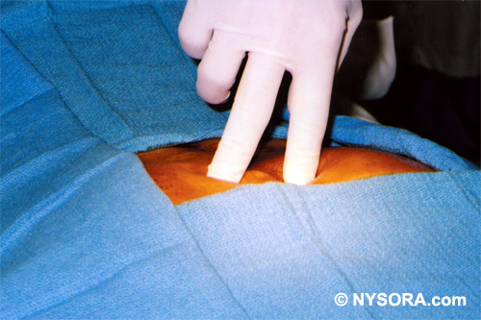
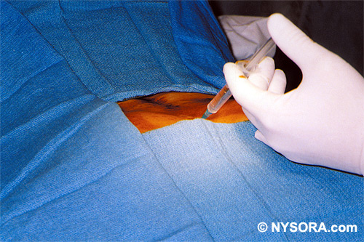
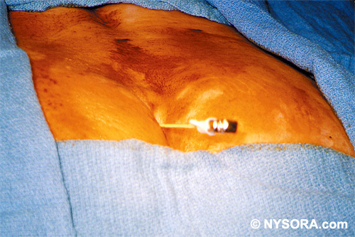
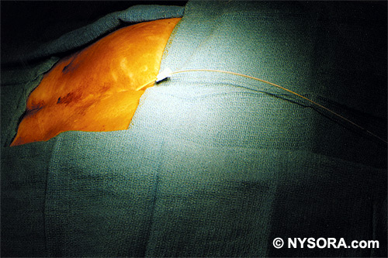
Anatomic Landmarks

Slide 12
Clinical Pearls
The needle tip should stay below the S2 level to avoid tearing the dura and should never be advanced in the space to the full length of the shaft.
The skin corresponding to about 1 cm inferior to the PSIS indicates the S2 level (caudal most extension of the dura mater(.
The dural sac extends lower in children than in adults, and epidural needles should be very carefully advanced no deeper than the S3 or S4 level in this patient population.
In pediatric patients, electrical stimulation has been used to ascertain correct needle placement in the caudal canal. Anal sphincter contraction (corresponding to stimulation of S2-4) can be sought with a current of 1-10 mA.
If the needle has been inserted correctly, it will swing easily from side to side at the hub while the shaft is held like a fulcrum at the sacrococcygeal membrane and the tip moves freely in the sacral canal.

Slide 13
If cerebrospinal fluid (CSF) is aspirated through the needle, it should be withdrawn and injection should not be undertaken.
If blood is aspirated, the needle should be withdrawn and reinserted until no blood is apparent at the hub.
When injection of air (or saline) for the loss-of-resistance technique results in a bulging over the sacrum, the needle tip most probably lies dorsal to the sacrum in the subcutaneous tissues.
If the needle tip is subperiosteal, the injection will meet with significant resistance, and the patient will find this to be a most unpleasant experience. The cortical layer of the sacral bone is often quite thin, particularly in infants and older subjects, and puncture of cancellous bone is relatively easy, especially if force is exerted while advancing the needle. The sensation of entering cancellous bone is not unlike penetrating the sacrococcygeal membrane; there is a feeling of resistance that is suddenly overcome and the needle advances more freely and subsequent injection is unhampered.

Slide 14
Typical Local Anesthetics for Caudal Block in Pediatric Patients (single shot)
Agent | Concentration (%) | Dose | Onset (min) | Duration of Action (min)
Ropivacaine[50] | 0.2 | 2 mg/kg | 9 | 520
Bupivacaine[50] | 0.25 | 2 mg/kg | 12 | 2553
Ropivacaine[51] | 0.2 | 0.7 mg/kg | 11.7 | 491
Bupivacaine[51] | 0.25 | 0.7 mg/kg | 13.1 | 457
Ropivacaine[52] | 0.2 | 1 mg/kg | 8.4 | Not available
Levobupivacaine[52] | 0.25 | 1 mg/kg | 8.8 | Not available
Bupivacaine[52] | 0.25 | 1 mg/kg | 8.8 | Not available

Slide 15
Spread of the Local Anesthetic Solutions
The large capacity of the sacral canal accommodates correspondingly large volumes of solution; significant volumes may be lost through the wide anterior sacral foramina.
Therefore, the caudal dose requirements of local anesthetics are significantly larger to effect the same segmental spread than are the corresponding lumbar doses.
Roughly twice the lumbar epidural local anesthetic dose is needed for caudal blockade to attain similar levels of analgesia and anesthesia, and solutions injected in the caudal space take longer to spread .

Slide 16
Pharmacologic Considerations for Caudal Epidural Anesthesia in Children
Anesthetic dose requirements are about 0.1 mL/ segment/year of age for 1% lidocaine or 0.25% bupivacaine. The dose may also be calculated based on body weight.
The relationship between age and dose requirements is strictly linear with a high degree of correlation up to 12 years old.
Plasma bupivacaine concentrations in children receiving caudal block with 0.2% of the local anesthetic (2 mg/kg) were less than equivalent doses administered via ilioinguinal-iliohypogastric block for pain control following herniotomy or orchidopexy. Additionally, the times to peak plasma concentrations were faster in the peripheral nerve block group, indicating that caudal block is a safe alternative to local infiltration techniques in inguinal surgery.
Although caudal block is a mainstay of perioperative pain management in pediatric surgery and represents probably 60% of all regional anesthetic techniques in this patient population, not all studies demonstrated a marked benefit of caudal block for postoperative analgesia compared with other modalities

Slide 17
Caudal epidural block in children may induce significant changes in descending aortic blood flow while maintaining heart rate and mean arterial blood pressure.
In a study of 10 children age 2 months to 5 years, a transesophageal Doppler probe was used to calculate hemodynamic variables after the injection of 1 mL/kg of 0.25% bupivacaine with epinephrine 5 mcg/mL. The aortic ejection volume increased, and aortic vascular resistance decreased by about 40%.
These data suggest that caudal block results in vasodilatation secondary to sympathetic nervous system blockade.

Slide 18
Local Anesthetics Commonly Used for Caudal Anesthesia in Adults^{a,b}
Agent | Concentration (%) | Dose (mg) | Sensory Onset (4-segment spread) (min) | Duration (2-segment regression) (min)
Lidocaine | 1.5-2 | 300-600 | 10-20 | 90-150
Chloroprocaine | 2-3 | 400-900 | 8-15 | 45-80
Mepivacaine | 2 | 400-600 | 10-20 | 90-240
Ropivacaine | 0.75-1 | 150-300 | 15-25 | 120-210
Bupivacaine/ Levobupivacaine | 0.5-0.75 | 100-225 | 10-25 | 180-270
ªAll solutions with epinephrine 1:200,000, except ropivacaine. ^{b}All doses and times approximate.

Slide 19
Bromage noted that age is not correlated with caudal segmental spread in adults and the upper level of analgesia resulting from 20-mL doses of local anesthetic solution varies widely between S2 and T8.
This unpredictability limits the usefulness of applying caudal anesthesia for surgical procedures that require cephalad analgesia levels above the pelvic level or the umbilicus.
A recent study reconfirmed Bromage's findings. In 172 women undergoing minor gynecologic surgery using caudal anesthesia with 20 mL of 1.5% lidocaine, the highest sensory dermatome level reached was below T10.

Slide 20
Complications Associated With Caudal Epidural Block
The complications of caudal block are similar to those occurring following lumbar epidural block and include complications related to the technique itself and complications related to related to the injectate (local anesthetic or other injected substance).
Fortunately, serious complications occur infrequently.
The list of possibilities includes: epidural abscess, meningitis, epidural hematoma, dural puncture and postdural puncture headache, subdural injection, pneumocephalus and air embolism, back pain, and broken or knotted epidural catheters.

Slide 21
Systemic Toxicity of Local Anesthetics
The incidence of local anesthetic-induced seizures occurs more frequently following caudal epidural block than it does following lumbar or thoracic approaches.
In a retrospective study of 25,697 patients who received brachial plexus blocks, caudal or lumbar epidural blocks from 1985 to 1992, Brown noted 26 seizures. The frequency of seizures in adults was caudal > brachial plexus block > lumbar or thoracic epidural block. Nine overall seizures were attributed to local anesthetic injection in the caudal space, eight occurring with chloroprocaine and one occurring with lidocaine. There was a 70-fold increased incidence (0.69%) of local anesthetic toxic reactions with caudal epidural anesthesia than with lumbar or thoracic epidural anesthesia in adults.

Slide 22
In children, however, one retrospective review identified only two toxic reactions (i.e., local anesthetic-induced seizures) in 15,000 caudal blocks.
Dalens' group found that inadvertent intravascular injection occurs in up to 0.4% of pediatric caudal blocks, demonstrating the importance of performing epinephrine-containing test dosing in this age group. It has been suggested that an elevation of heart rate by > 10bpm or an increase in systolic blood pressure of > 15 mm Hg should be taken as indicative of systemic injection. T wave changes on the ECG occur earliest following intravascular injection, followed by heart rate changes, and lastly, by blood pressure changes

Slide 23
